Slide 1


Loops
Execute Blocks of Code Multiple Times
JavaScript Fundamentals
Telerik Software Academy
http://academy.telerik.com

Slide 2

Table of Contents
What is a Loop?
Loops in JavaScript
while loops
do … while loops
for loops
Special loop operators
break, continue
Nested loops

Slide 3
What Is Loop?
A loop is a control statement that allows repeating execution of a block of statements
May execute a code block fixed number of times
May execute a code block while given condition holds
May execute a code block for each member of a collection
Loops that never end are called an infinite loops

Slide 4

Using while(…) Loop
Repeating a Statement While Given Condition Holds

Slide 5
How To Use While Loop?
The simplest and most frequently used loop
The repeat condition
Also called loop condition
Is not necessary true or false
Is evaluated to true or false
5, "non-empty", etc.. are evaluated as true
0, "", null are evaluated as false
while (condition) {
statements;
}

Slide 6
While Loop – How It Works?
condition
false
true
statement

Slide 7
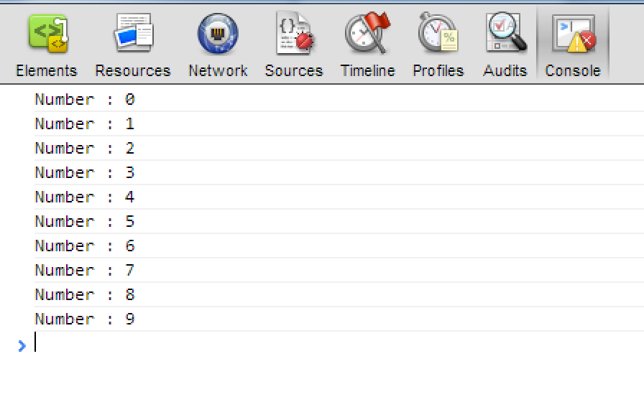
While Loop – Example
var counter = 0;
while (counter < 10) {
console.log('Number : ' + counter);
counter+=1;
}

Slide 8

while(…)
Examples

Slide 9
Sum 1..N – Example
Calculate and print the sum of the first N natural numbers
var nStr = '123',
n = +nStr,
number = 1,
sum = 1,
result = 'The sum 1';
while (number < n) {
number += 1;
sum += number ;
result += '+' + number;
}
result += ' = ' + sum;
console.log(result);

Slide 10
Prime Number – Example
Checking whether a number is prime or not
var numberStr = '123';
var number = +numberStr;
var divider = 2;
var maxDivider = Math.sqrt(number);
var prime = true;
while (prime && (divider <= maxDivider)) {
if (!(number % divider)) {
prime = false;
}
divider++;
}
print('output-tb',prime);

Slide 11
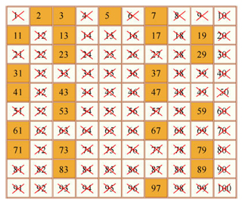
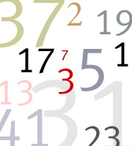
While Loop
Live Demo

Slide 12
Using break Operator
break operator exits the inner-most loop
var numberStr = '123‘,
n = +numberStr,
fact = 1,
factStr = 'n! = ';
while (1) { //infinite loop
if (n === 1) {
break;
}
factStr += n + '*'
fact *= n;
n -= 1;
}
factStr += '1 = ' + fact;
console.log(factStr);

Slide 13
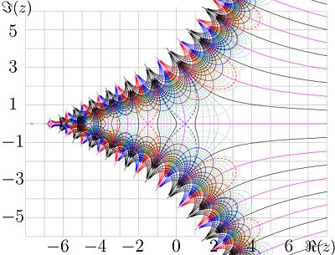
Calculating Factorial
Live Demo

Slide 14

do { … } while (…) Loop

Slide 15

Using Do-While Loop
Another loop structure is:
The block of statements is repeated
While the boolean loop condition holds
The loop is executed at least once
do {
statements;
} while (condition);

Slide 16
Do-While Statement
statement
true
condition
false

Slide 17

do { … } while (…)
Examples

Slide 18
Factorial – Example
Calculating N factorial
var fact = 1,
factStr = 'n! = ';
do {
fact *= n;
factStr += n + '*'
n -= 1;
} while (n);
factStr += ' = ' + fact;
console.log(factStr)

Slide 19
Product[N..M] – Example
Calculating the product of all numbers in the interval [n..m]:
var number = n,
product = 1,
productStr = '';
do {
product *= number;
productStr += number;
if (number != m) {
productStr += '*';
}
number += 1;
} while (number <= m);
productStr += ' = ' + product;
console.log(productStr);

Slide 20
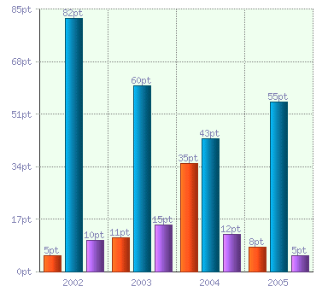
do-while Loop
Live Demo

Slide 21

for Loops

Slide 22
For Loops
The typical for loop syntax is:
Consists of
Initialization statement
Test expression that is evaluated to boolean
Update statement
Loop body block
for (initialization; test; update) { statements; }

Slide 23
The Initialization Expression
for (var number = 0; number < 10; number += 1) { // Can use number here } // Cannot use number here
Executed once, just before the loop is entered
Like it is out of the loop, before it
Usually used to declare a counter variable

Slide 24
The Test Expression
for (var number = 0; number < 10; number += 1) { // Can use number here } // Cannot use number here
Evaluated before each iteration of the loop
If evaluated true, the loop body is executed
If evaluated false, the loop body is skipped
Used as a loop condition

Slide 25
The Update Expression
for (var number = 0; number < 10; number += 1) { // Can use number here }
Executed at each iteration after the body of the loop is finished
Usually used to update the counter

Slide 26

for Loop
Examples

Slide 27
Simple for Loop – Example
A simple for-loop to print the numbers 0…9:
var number;
for (number = 0; number < 10; number += 1) {
console.log(number + ' ');
}
A simple for-loop to calculate n!:
var factorial = 1,
i;
for (i = 1; i <= n; i += 1) {
factorial *= i;
}

Slide 28
Complex for Loop – Example
Complex for-loops could have several counter variables:
var i, sum;
for (i=1, sum=1; i<=128; i=i*2, sum+=i) {
console.log('i=' + i + ', sum=' +sum);
}
Result:
i=1, sum=1
i=2, sum=3
i=4, sum=7
i=8, sum=15
...

Slide 29
N^M – Example
Calculating n to power m (denoted as n^m):
var result = 1,
i;
for (i = 0; i < m; i += 1) {
result *= n;
}
console.log(result);

Slide 30

Calculating N^M
Live Demo

Slide 31

Nested Loops
Using Loops Inside a Loop

Slide 32
What Is Nested Loop?
A composition of loops is called a nested loop
A loop inside another loop
Example:
for (initialization; test; update) {
for (initialization; test; update) {
statements;
}
…
}

Slide 33

Nested Loops
Examples

Slide 34
Triangle – Example
Print the following triangle:
1
1 2
…
1 2 3 ... n
var resultStr = '',
row, col;
for(row = 1; row <= n; row += 1) {
for(column = 1; column <= row; column += 1) {
resultStr += column + ' ';
}
resultStr += '\n';
}
console.log(resultStr);

Slide 35

Triangle
Live Demo

Slide 36
Primes[N, M] – Example
Print all prime numbers in the interval [n, m]:
var result='',
number, isPrime, divider, maxDivider;
for (number = n; number <= m; number++) {
isPrime = true;
divider = 2;
maxDivider = Math.sqrt(number);
while (divider <= maxDivider) {
if (!(number % divider)) {
isPrime = false;
break;
}
divider += 1;
}
if (isPrime) {
result += number + ' ';
}
}

Slide 37

Primes in Range [n, m]
Live Demo

Slide 38

Loops – More Examples

Slide 39
Nested Loops – Examples
Print all four digit numbers in format ABCD such that A+B = C+D (known as happy numbers)
Can you improve this algorithm to use 3 loops only?
var a, b, c, d
for (a =1 ; a <= 9; a += 1) {
for (b = 0; b <= 9; b += 1)
for (c = 0; c <= 9; c += 1)
for (d = 0; d <= 9; d += 1)
if (a + b == c + d)
console.log('{0}{1}{2}{3}',
a, b, c, d);
}

Slide 40
Nested Loops – Examples
Print all combinations from TOTO 6/49
Warning: execution of this code could take too long time.
var i1, i2, i3, i4, i5, i6;
for (i1 = 1; i1 <= 44; i1+=1)
for (i2 = i1 + 1; i2 <= 45; i2+=1)
for (i3 = i2 + 1; i3 <= 46; i3+=1)
for (i4 = i3 + 1; i4 <= 47; i4+=1)
for (i5 = i4 + 1; i5 <= 48; i5+=1)
for (i6 = i5 + 1; i6 <= 49; i6+=1)
console.log('{0} {1} {2} {3} {4} {5}',
i1, i2, i3, i4, i5, i6);

Slide 41
for-in Loop
Iterating over the properties of object

Slide 42
for-in Loop
for-in loop iterates over the properties of an object
When the object is array, nodeList or liveNodeList for-in iterates over their elements
When the object is not an array, for-in iterates over its properties

Slide 43
for-in Loop (2)
Iterating over the elements of an array
Iterating over the properties of document
var arr = [1, 2, 3, 4, 5, 6],
index;
for(index in arr) { console.log(arr[index]); }
//1, 2, 3, 4, 5, 6
var prop;
for(prop in document){ console.log(document[prop]); }
//http://localhost:64765/xxx%20for-in-loop.html
//function querySelector() { [native code] }
//function querySelectorAll() { [native code] }
//function evaluate() { [native code] }

Slide 44
for-in Loop
Live Demo

Slide 45
for-of Loop
The new guy on the block

Slide 46
The for-of loop
The for-of loop iterates over the elements in an array
Can be used only on arrays, or array-like objects
i.e. the arguments object
var arr = ['One', 'Two', 'Three', 'Four'];
for(var n of arr) {
console.log(n);
}
//prints 'One', 'Two', 'Three' and 'Four'
The for-of loop is part of the ECMAScript 6 standard
Supported in all modern browsers

Slide 47
for-of Loop
Live demo

Slide 48


Loops
http://academy.telerik.com

Slide 49




Free Trainings @ Telerik Academy
"Web Design with HTML 5, CSS 3 and JavaScript" course @ Telerik Academy
html5course.telerik.com
Telerik Software Academy
academy.telerik.com
Telerik Academy @ Facebook
facebook.com/TelerikAcademy
Telerik Software Academy Forums
forums.academy.telerik.com

